Slide 1

Robotics Applications EEL 5661
Military Robotics for Ground Battle Operations Q-GUV
Shaun Pritchard - spritchard2021@fau.com - Fall 2022

Slide 2
Table of Contents
1
3
2
4
Intro
Military Applications
Overview of Military ground applications
Current applications used in the military.
Robotics Developers
Q-UGV
Where the technology is developed and current state of the art.
Quadrupedal Unmanned Ground Vehicles.

Slide 3
Introduction
MIlitary Robotics Applications for Ground Battle Operations

Slide 4
What are Military Ground Applications In Robotics
Multiple Technologies and applications
Semi-autonomous
Fully-autonomous
Depending on the application requirements, sensors, detectors, weapons, programmed software, and other payloads can be equipped on robots used in the military
Notes:
Robots consist of different types of payloads depending on the application. Depending on the application requirements, sensors, detectors, weapons, programmed software, and other payloads can be equipped on robots used in the military.

Slide 5
Top Military Robotics Companies
BOSTON DYNAMICS
DARPA
Defense Advanced Research Projects Agency.
GHOST ROBOTICS
Notes:
Currently the US Military developers, test, and uses applications from The Following companies
The military has been developing various new robot technologies that can assist armies in case of war with various applications for decades. DARPA, for instance, is funding a robotic submarine system that could be used for detecting underwater mines, conducting anti submarine operations, and protecting ships in harbors.
The Strategic Computing Initiative (SCI) was launched by DARPA in 1983 with the sole goal of advancing artificial intelligence and robots integrated plans to promote computer chip design, computer architecture, and artificial intelligence software.

Slide 6

Military Market Share of Robotics
2022 YTD 30 % of US military uses Robotics applications
US Military
Military Contracting
Notes:
military robots industry is expected to reach USD 30.83 billion by 2022
growing at a CAGR of 12.92%.
30% of US military is using Robotics and AI

Slide 7
3-Types of Military Robots
Unmanned Ground Vehicles (UGV) Robots
Unmanned Aerial Vehicle (UAV) Robots
Unmanned Underwater Vehicle (UUV) Robots
Notes:
Unmanned Ground Vehicles (UGV) Robots
Unmanned Ground Vehicles (UGV) are autonomous or semi-autonomous robotics with various applications.
Unmanned Aerial Vehicle (UAV) Robots
These robots are also known as Drones and raptors capable of flying by remote control or autonomously to deliver ordinances to targets or serve some military function.
Unmanned Underwater Vehicle (UUV) Robots
These robots can maneuver and operate underwater autonomously

Slide 8
Unmanned Ground Vehicles (UGV) Robots
UGV’s
Military Transportation Robots
Search And Rescue Military Robots
Fire Fighting Military Robots
Mine Clearance Military Robots
Surveillance And Reconnaissance Military Robot
Armed Military Robots
Notes:
Military Transportation Robots
Transport roles are performed by these robotic soldiers. These vehicles can transport bombs, artillery, military supplies, soldgers, and other materials for the soldiers. While most of these military robots have wheels, some have legs to enable them to move over rough terrain. Using military robots for transportation increases logistics efficiency and assists soldiers in their movements as well. Materials are carried to the battlefield by them. They also assist in picking up casualties from the battlefield and help soldiers to avoid life threatening combat situations. For instance, an Autonomous Platform Demonstrator (APD) is an Army Tank-Automotive Research vehicle commonly used for transport.
Search And Rescue Military Robots
The use of robot search and rescue soldiers can also be useful during natural disasters like tsunamis, earthquakes, and artificial disasters like Chernobyl or 9/11. Search and rescue missions are carried out by military robots of this type. Rescue missions on land or in the water can save lives and reach places where a normal human cannot. They are also useful in times of floods, wildfires, earthquakes, wrecks, and other disasters.
Fire Fighting Military Robots
Robots of this type are used to put out fires and save lives. Unlike humans, they are able to withstand elements that humans cannot.
Mine Clearance Military Robots
The use of this type of battle robot is useful in warzones and areas where mines, bombs, and other explosive items may cause harm to humans.
Surveillance And Reconnaissance Military Robots
There are many military robots that can be used in surveillance and investigation missions. As a result of these robot soldiers, the enemy can be spied on with greater accuracy
Armed Military Robots
The robots in this type are armed with weapons and can shoot live ordinances and protect soldiers and defend military resources..

Slide 9
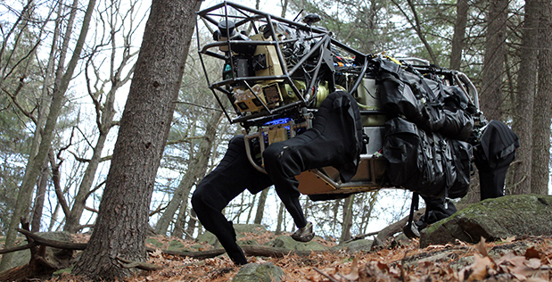
Notes:
LS3 Pack Mule
To help alleviate physical weight on troops, DARPA developed a four-legged robot, the Legged Squad Support System (LS3), to integrate with squads of Marines or Soldiers. LS3 demonstrated that a highly mobile, semi-autonomous legged robot could carry 400 lbs of a squad’s load, follow squad members through rugged terrain and interact with troops in a natural way, similar to a trained animal and its handler.
The LS3 program goal was to develop a robot that could go through the same terrain the squad goes through without hindering the squad’s mission. The robot could also serve as a mobile auxiliary power source to the squad, so troops could recharge batteries for radios and handheld devices while on patrol.
In January 2012, the LS3 prototype completed its first outdoor assessment, demonstrating mobility by climbing and descending a hill and exercising its perception capabilities. A two-year, platform-refinement test cycle began in July 2012, with U.S. Marine Corps and U.S. Army involvement, culminating in a capstone exercise where LS3 embedded with Marines conducting field exercises.
LS3 represents the culmination of a decade of research in perception and autonomy with programs like DARPA’s Unmanned Ground Combat Vehicle-Perception for Off-Road Robotics Integration (UPI) program, mobility work with DARPA’s “Big Dog” and significant advances in natural human-robot interface such as voice recognition.

Slide 10
Unmanned Aerial Vehicle (UAV) Robots
UAV’s
Drones
Flying Robots!
Notes:
These robots are also known as Drones and raptors capable of flying by remote control or autonomously to deliver ordinances to targets or serve some military function.

Slide 11
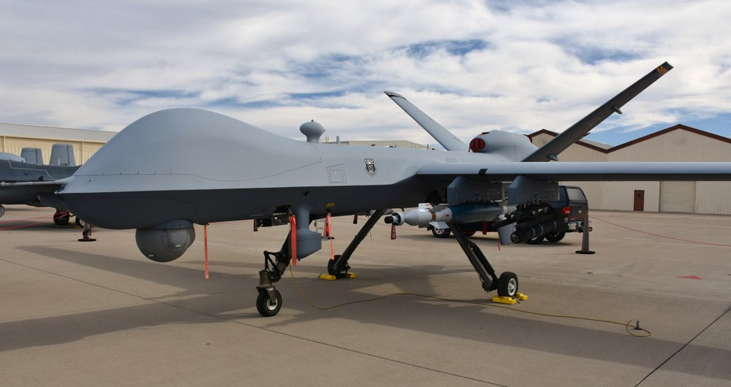
Notes:
An unmanned combat aerial vehicle (UCAV), also known as a combat drone, colloquially shortened as drone or battlefield UAV, is an unmanned aerial vehicle (UAV) that is used for intelligence, surveillance, target acquisition, and reconnaissance and carries aircraft ordnance such as missiles, ATGMs, and/or bombs.

Slide 12
Unmanned Underwater Vehicle (UUV) Robots
UUV’s
Unmanned Surface Vehicles
Unmanned Undersea Vehicles
Underwater Robots!
Notes:
Unmanned underwater vehicles (UUV), sometimes known as underwater drones, are submersible vehicles that can operate underwater without a human occupant. These vehicles may be divided into two categories: remotely operated underwater vehicles (ROUVs) and autonomous underwater vehicles (AUVs).

Slide 13
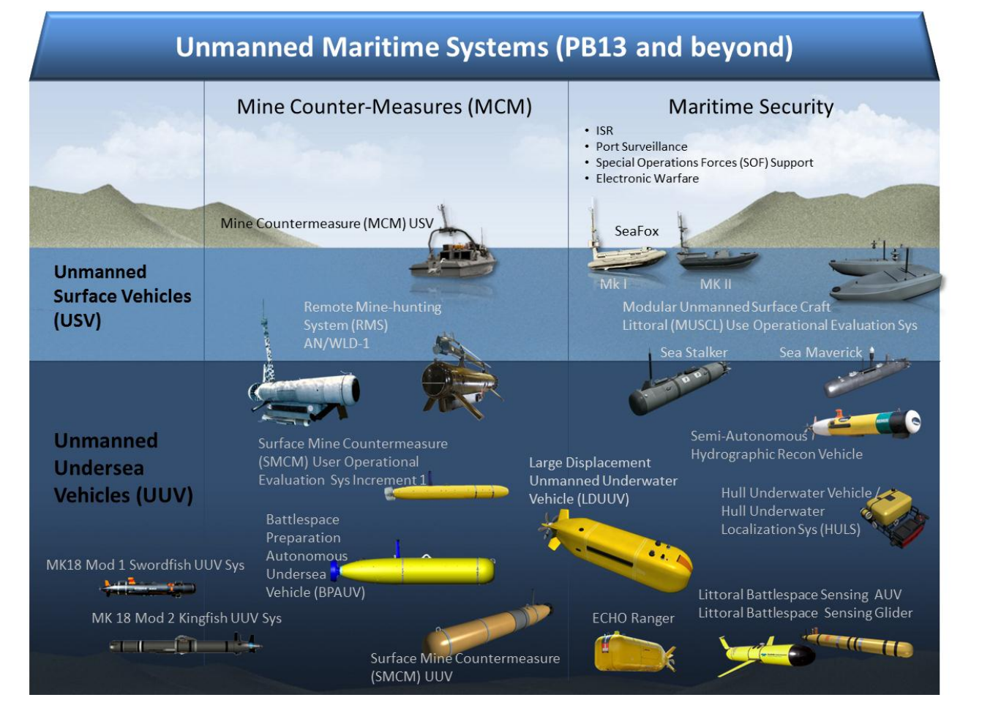
Notes:
An unmanned combat aerial vehicle (UCAV), also known as a combat drone, colloquially shortened as drone or battlefield UAV, is an unmanned aerial vehicle (UAV) that is used for intelligence, surveillance, target acquisition, and reconnaissance and carries aircraft ordnance such as missiles, ATGMs, and/or bombs.

Slide 14
Quadrupedal Unmanned Ground Vehicles (Q-UGV)
Q-UGV
Surveillance
Armed / unarmed Security
Transport
Rescue
Mine Clearance
Detection
Military target engagement
Reconnaissance
Ground Military Robotics Applications of the future!
Notes:
Including surveillance, transport, armed security, rescue, surveillance, and mine clearance, as well as the extermination of strategic military targets.

Slide 15
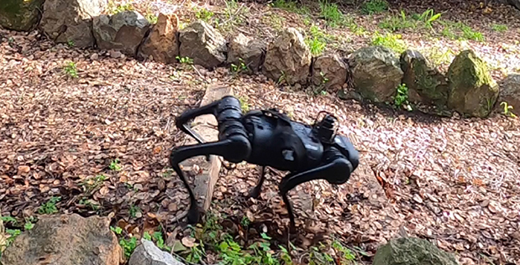
Notes:
The Portland Air National Guard Base became the first Air National Guard base in 2021 to implement Q-UGV A.K.A ( autonomous defenders) for its armed security patrol units at the base. Since then many other military installations have adopted the technology for military security. This robot can operate in unknown environments and return to position regardless of the failure of the vision sensors or the slippage of the robot. Ghost V60 quadrupeds are expected to enhance ground-based forces' situational awareness. Additionally, it will act as the eyes and ears of frontline soldiers. Four-legged robots can traverse different terrains, including rocks, sand, hills, and stairs. Complex environments can be navigated by walking, running, crawling, climbing, and swimming. Sensors can be equipped with RGB and time-of-flight (TOF) sensors for surround-sensing, as well as thermal/infrared (IR) sensors. Moreover, it can be equipped with CBRN and specialty sensors. As a result of the integration of light detection and ranging (LIDAR) imaging systems, users can obtain 3D imaging of the surrounding environment in order to assess potential threats. A 360-degree camera offers 360-degree views, which enhances situational awareness, which is important for planning effective strategies. There are currently trials of 5G connectivity on the V60, which also has Wi-Fi and dual-sim 4G/LTE connectivity.

Slide 16
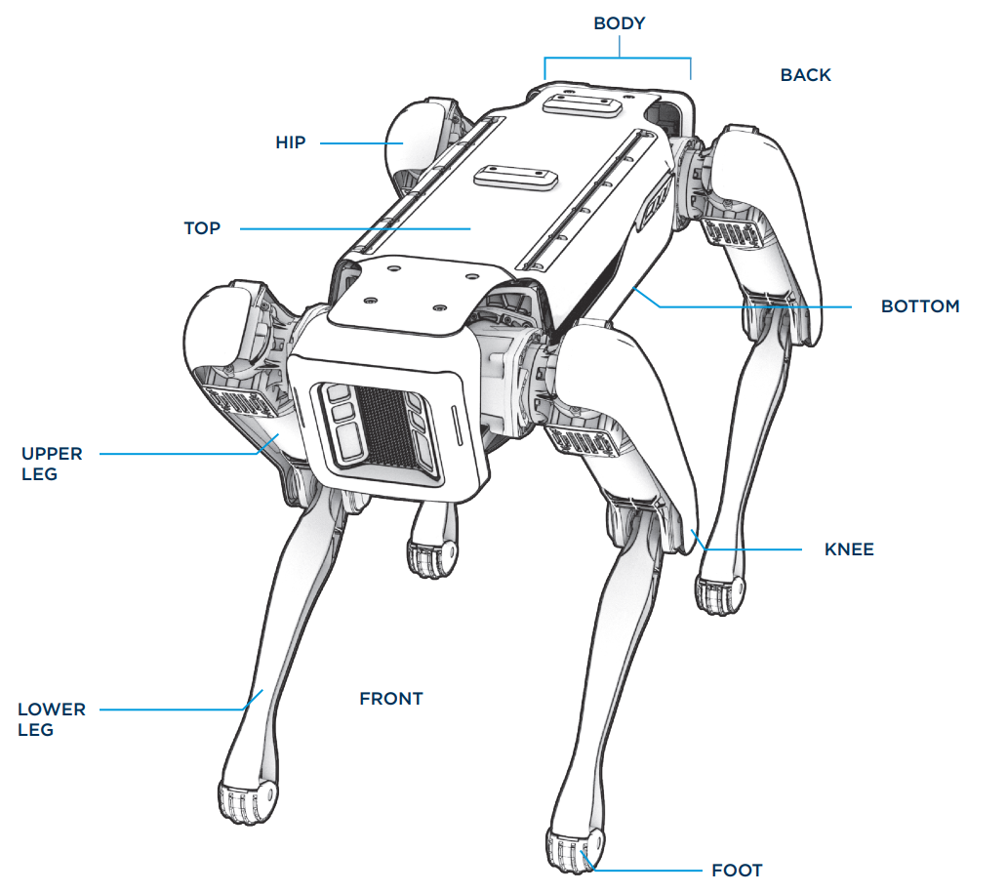
Notes:
Typically Quadrupedal Unmanned Ground Vehicles are built with 4 frames and 12 to 15 degrees of freedom. With 3 degrees of freedom in each leg and other DOF for additional drivetrains. They use onboard electrical systems and lithium ion batteries. Voltage regulators can help adjust the voltage depending on the requirements of the motors, sensors, and the onboard CPU with multiple navigation systems and logic operators that are controlled by smart AI models. With MCS AI models, DARPA seeks to construct computational models that mimic the core domains of child cognition for objects (intuitive physics), agents (intentional actors), and places (spatial navigation).

Slide 17
Thanks!
Shaun Pritchard
M.S In Artificial Intelligence
Florida Atlantic University - Department of Engineering and Computer Science
Email: spritchard2021@fau.edu

